Slide 1
Topic 8 Virtual Private Network (VPN)
ST251 Ethical Hacking and Defences

Slide 2
Topic 6 : VPN
Explain basic VPN concepts
Describe encapsulation in VPNs
Describe encryption in VPNs
Describe authentication in VPNs
Summarize the advantages and disadvantages of VPNs
Understand design considerations for a VPN
Describe guidelines for auditing VPNs and VPN policies

Slide 3
Understanding VPN Concepts
Virtual Private Network (VPN) enables computers to
Communicate securely over insecure channels
Exchange private encrypted messages that others cannot decipher

Slide 4
What VPNs are
Virtual network connection
Uses the Internet to establish a secure connection (tunnel)
Extends an organization’s network
Computers can be part of the network even though they are located physically in other places
Endpoints
Specified computers, users, or network gateways

Slide 5
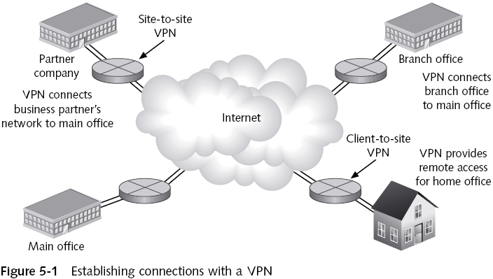

Slide 6
Why Establish a VPN?
Business incentives for VPN adoption
VPNs are cost-effective
VPNs provide secure connection for remote users (business partners, travelling employees, etc)
Good solution for organisations that need to keep costs down while maintaining security

Slide 7
Exercises
Try accessing a shared file over the network without encryption first
Practical 8 Exercises 1 and 2

Slide 8
VPN Components
VPN server or host
Configured to accept connections from clients
VPN client or guest
Endpoints connecting to a VPN
Tunnel
Connection through which data is sent
VPN protocols
Sets of standardized communication settings
Used to encrypt data sent along the VPN

Slide 9
Types of VPNs
Site-to-site VPN
Link two or more networks
Gateway-to-gateway VPN
Client-to-site VPN
Link remote users to network
Remote access VPN

Slide 10
Hardware VPNs
Connect one gateway to another
Hardware VPNs can be routers at each network gateway that encrypt and decrypt packets
Also called VPN appliance
Designed to serve as VPN endpoint
Join multiple LANs
Benefits
Scalable – can handle more network traffic compared to software products
Better security – not dependent on a computer’s operating system

Slide 11
Hardware VPNs

Slide 12
Software VPNs
Usually integrated with firewalls
Appropriate when participating networks use different routers and firewalls
Benefits
More cost-effective
Offer maximum flexibility

Slide 13
VPN Combinations
Combining VPN hardware with software adds layers of network security
One useful combination is a VPN bundled with a firewall
VPNs do not eliminate the need for firewalls
Provide flexibility and versatility
Points to consider when selecting VPN hardware and software
Compatibility, Scalability, Security, Cost, Vendor support

Slide 14
VPN Core Activities
Encapsulation
Encryption
Authentication

Slide 15
VPN Core Activity 1 : Encapsulation
Encloses a packet within another
With a different IP source and destination
Protects integrity of the data

Slide 17
Understanding Tunneling Protocols
VPNs link networks and gateways that might have different operating systems
Tunnelling protocols need to be in place so computers can communicate
IPsec with IKE – popular protocol suite used in VPNs
SSL – leverage Web-based applications and is also popular

Slide 18
IPsec/IKE
Internet Protocol Security (IPsec)
Set of standard procedures
Developed by the Internet Engineering Task Force (IETF)
Enables secure communications on the Internet
Characteristics
Works at layer 3
Can encrypt an entire TCP/IP packet
Originally developed for use with IPv6
Provides authentication of source and destination computers
Widely supported

Slide 19
IPsec/IKE (continued)
When computers establish IPsec connection, they set up Security Associations
Security Association (SA)
Relationship between two or more entities
Describes how they will use encryption, encapsulation and/or authentication, and the algorithms used
Used by IPsec to track all the particulars of a communication session
SAs are unidirectional (one-way). Two SAs will be required for two computers to communicate with each other

Slide 20
IPSec/IKE (continued)
Core Components
Authentication Header (AH)
Encapsulating Security Payload (ESP)
Other Components
Internet Security Association Key Management Protocol (ISAKMP) to establish the SA
Internet Key Exchange (IKE) to exchange keys
Oakley protocol
IPsecurity Policy Management
IPsec driver – software handling the encryption and authentication of packets

Slide 21
Authentication Header (AH)
Provides authentication of TCP/IP packets
Ensures data integrity
Packets are signed with a digital signature
Adds a header calculated by the values in the packet
Creating a message digest of the packet
Provides authentication and integrity but not privacy

Slide 22
Authentication Header (AH)
AH in tunnel mode
Authenticates the entire original header and data
Places a new header at the front of the original packet
AH in transport mode
Authenticates the original header and data, except for fields that can change during transit

Slide 23
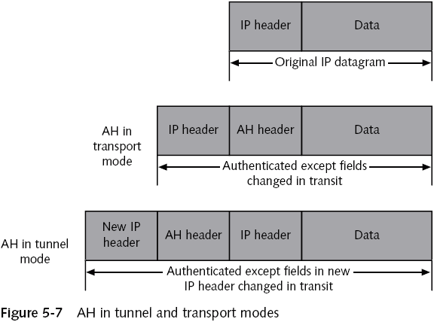

Slide 24
Encapsulating Security Payload (ESP)
Provides confidentiality for messages
Can encrypt different parts of a TCP/IP packet
Can also perform authentication
ESP in tunnel mode
Encrypts both the header and data part of each packet
ESP in transport mode
Encrypts only data portion of the packet

Slide 26
VPN Core Activity 2 : Encryption
Components
Encryption Key
Encryption Algorithms
Methods to set up keys between endpoints
Digital certificates
Internet Key Exchange (IKE)
Uses tunnel method to encrypt keys sent across Internet

Slide 28
Secure Sockets Layer (SSL)
Enables Web servers and browsers to exchange encrypted information
Characteristics
Uses public and private key encryption
Uses sockets method of communication
Operates at the higher layers (layer 5/6) of the OSI model
Widely used on the Web
Only supports data exchanged by Web-enabled applications
Unlikely to replace IPSec

Slide 29
How SSL works
Client (Web Browser) and Server (Web Server) need to establish a “SSL handshake”
Client connects to Web server using SSL protocol
Client sends its preferences for encryption method, SSL version number, and a randomly generated number
Server responds with SSL version number, its own cipher preferences, another random number and its digital certificate

Slide 30
How SSL works
Client verifies date and other information on the Server’s digital certificate
Client generates and send a “pre-master” code encrypted with server’s public key
Server uses its private key to decode pre-master code
Client and Server generates session keys from pre-master code that will be used to encrypt data sent across Internet

Slide 31
Transport Layer Security (TLS)
Regarded by many to be the successor of SSL
TLS 1.3 designed to offer
Better security
Improved speed

Slide 32
VPN Core Activity 3: Authentication
Identifying a user or computer as authorized to access and use network resources
Types of authentication methods used in VPNs
IPsec
Digital certificates

Slide 33
Kerberos
Authentication system
Developed at the Massachusetts Institute of Technology (MIT)
Authenticates the identity of network users
Authentication by assertion
Computer that connects to a server and requests services acts on behalf of an approved user

Slide 35
Kerberos
Advantages
Passwords are not sent across the network
They cannot be intercepted
Has a lower “network overhead” than a Public Key Infrastructure (PKI)
Handy for single sign-on (SSO)
Disadvantages
Authentication Server (Key Distribution Centre) is a single point of failure for Kerberos

Slide 36
VPN Advantages and Disadvantages

Slide 37
Exercises
Using OpenVPN
Accessing the shared file over the network through an encrypted tunnel
Practical 8 Exercises 3 to 6

Slide 38
Designing a VPN
Assess organization’s needs and goals
Type of business
How many employees it has
Infrastructure already in place
Security required
Remember to enforce security on the client side of the VPN tunnel
Most difficult aspect of the design process

Slide 39
Business Needs
A secure VPN design should address:
Secure connectivity
Availability
Authentication
Secure management
Reliability
Scalability
Performance
Cost is always an important factor

Slide 40
VPN topology
VPN topology
How components in a network are connected physically to one another
Determines how gateways, networks, and clients are related to each other
Corresponds to the basic physical and logical topologies of any network

Slide 41
Mesh topology
All participants in the VPN have Security Associations (SAs) with one another
Types of mesh arrangements
Full mesh
Partial mesh

Slide 43
Star topology
VPN gateway is the hub
Networks that participate in the VPN are called rim subnetworks
Separate SAs are made between the hubs of each rim subnetwork in the star configuration
Central VPN router is at organization’s central office
Any LANs or computers that want to participate need to connect only to the central server
Advantages/Disadvantages

Slide 45
Hybrid Topology
Combines two different network topologies
Central core uses a mesh topology
Mesh topologies tend to operate more efficiently
Branch offices can be connected using a star topology
Benefits from strengths of each topology
Scalability (of the star topology)
Speed (of the mesh configuration)

Slide 47
Using VPNs with Firewalls
VPNs do not reduce the need for a firewall
Always use a firewall as part of VPN security design
Different configurations for using VPNs and firewalls

Slide 48
VPN / Firewall Example 1 :
Install VPN software on the firewall itself
Firewall allows outbound access to the Internet
Firewall prevents inbound access from the Internet
VPN service encrypts traffic to remote clients or networks

Slide 50
VPN / Firewall Option 1 :
Install VPN software on the firewall itself
Advantages
Control all network access security from one server
Fewer computers to manage
Use the same tools for VPN and firewall
Disadvantages
Single point of failure
Must configure routes carefully
Internet access and VPN traffic compete for resources on the server

Slide 51
VPN / Firewall Option 2 :
Set up VPN parallel to your firewall inside the DMZ
Advantages
No need to modify firewall settings to support VPN traffic
Configuration scales more easily
Can deal with congested servers
Disadvantages
VPN server is connected directly to the Internet
If VPN server becomes compromised, attacker will have direct access to your internal network
Cost of supporting a VPN increases with new servers

Slide 52
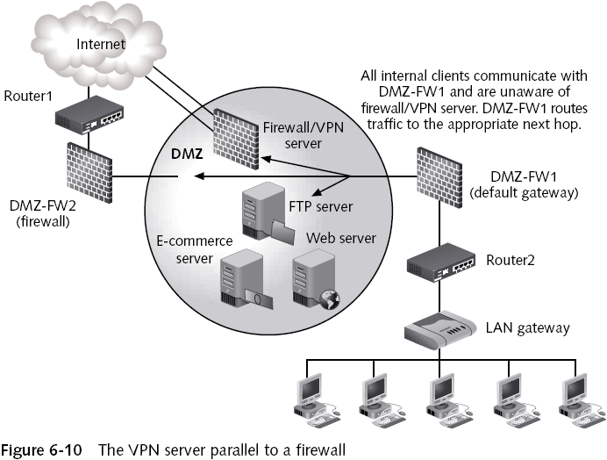

Slide 53
VPN / Firewall Option 3 :
Set up VPN server behind the firewall connected to the internal network
Advantages
VPN server is completely protected from the Internet
Firewall is the only device controlling access
VPN traffic restrictions are configured on VPN server
Disadvantages
VPN traffic must travel through the firewall
Firewall must handle VPN traffic
Firewall might not know what to do with IP protocols other than ICMP, TCP, and UDP

Slide 54
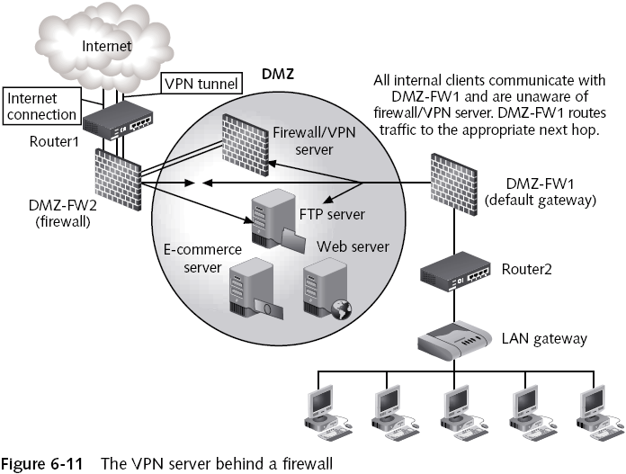

Slide 55
Auditing VPNs and VPN Policies
Auditing needed to make sure organizations have a well-defined VPN policy
Access policies define standards for connecting to the organization’s network
Policies should be defined for different levels of restrictions
VPN endpoints are as vulnerable as internal network computers
Endpoints should also use antivirus software and personal firewalls

Slide 56
Auditing VPNs and VPN Policies
Test each client that will connect to your LAN
Helps prevent network threats
You can standardize the VPN client for remote users
Verify everything is working according to your policies

Slide 57
Exercises
Using pfSense and OpenVPN
Practical 8a

